Slide 1
Project meeting
IoT Group
2019.05.31

Slide 2
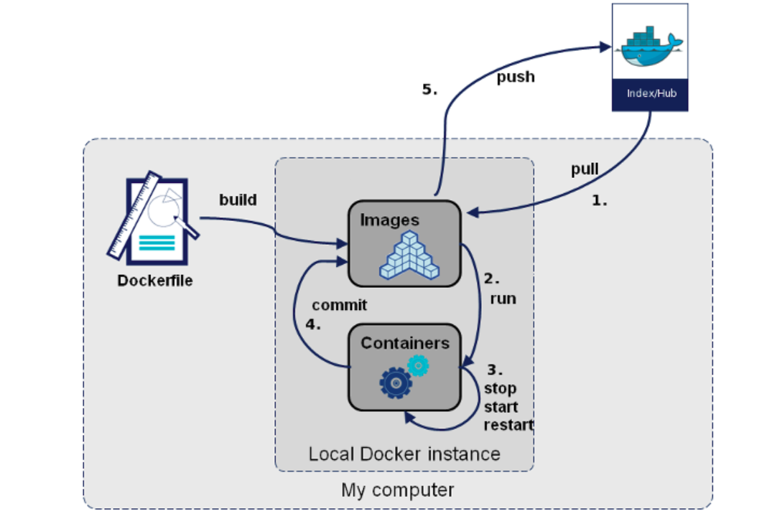
Docker Flow
Docker Registry : Docker Hub Registry
commit
save
export

Slide 3
Progress Work
Build an image for TensorFlow and Keras using Dockerfile without exporting the container
Preprocess the dataset

Slide 4
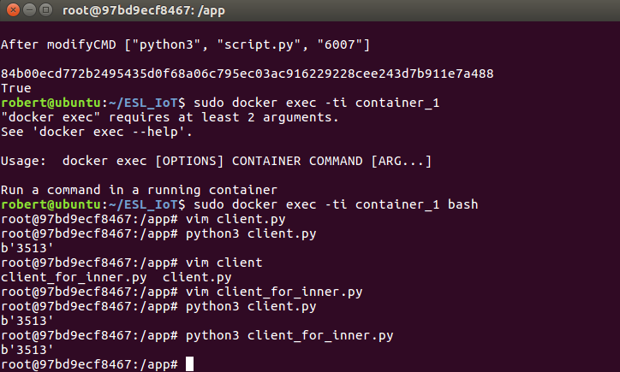
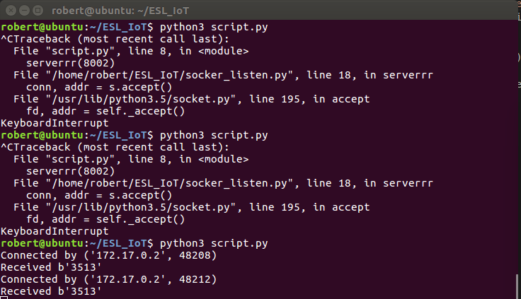
Send data from container to host
Container_1
HOST

Slide 5
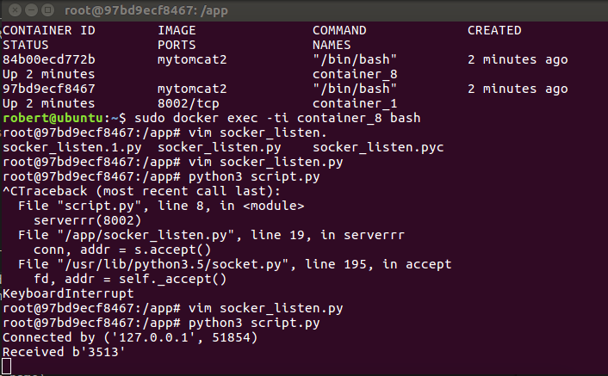
Send data between Container_1 and Container_2
Container_2
Container_1

Slide 6
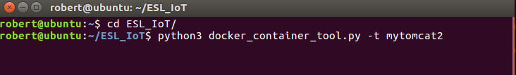
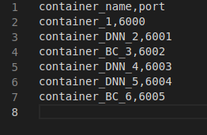
Add new command
1
2

